Slide 1
Open Source Software (A build v buy decision)
Acctg & Fin | BUS AN 500 | Class 06
Spring Qtr | 2026

Slide 2

What will we do today?
Review
Accounting & finance function
RPA & Agents
Investment Decisions Lab
Build v. Buy & Uncertainty
Final Project
Background: Enterprise AI implementation rates
Team check in & time to build

Slide 3
Accounting & Finance Function
External Users
Owners and other stakeholders
Banks
Internal Users
Users within a Company
Board of Directors
Managers
Employees
Investors
Shareholders
External Auditor
Creditors
Tax Agencies
Media
Students
Governments

Slide 4
An information and decisions approach
 | Financial Accounting | Managerial Accounting
Users and decision makers | External: Investors, creditors, and other external users | Internal: Managers, employees
Purpose of the information | Help external users make investment, credit and other decisions | Help managers make planning and control decisions
Flexibility of reporting | Structure, follows GAAP requirements plus voluntary disclosures | Flexible; can be structured as to best inform managers
Timeliness of information | Public after period end after an audit | Available on demand
Time dimension | Historical information with some projections | Future information, including projections and forecasts backed with historical data
Focus of information | Aggregate entity-level with some segmented data | Detailed around projects, processes and divisions
Nature of information | Monetary with voluntary non-monetary | Monetary and non-monetary including KPIs

Slide 5
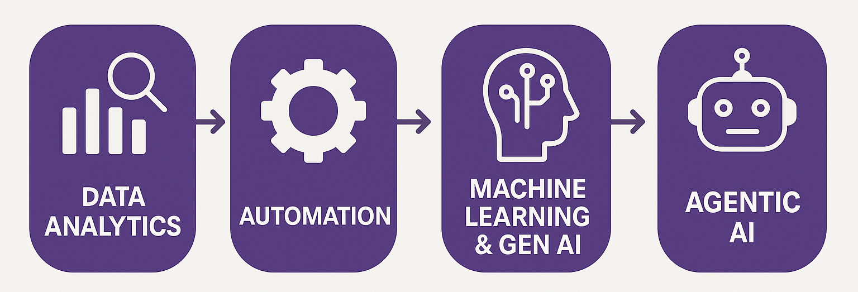
Process Diagram
How can we use data analytics and automation tools to improve decisions?

Slide 6
RPA helpers versus Agent helpers
Step | RPA (Automation) | Agent (Interpretation)
Data ingestion | Reads budget and actuals | —
Aggregation | Computes totals and variances | —
Detection | Flags differences | —
Interpretation | — | Explains what happened
Prioritization | — | Identifies what matters most
Recommendation | — | Suggests actions
Decision | — | Supports human judgment

Slide 7
RPA helpers versus agent helpers
RPA answers: “What happened?”
Agents answer: “What does it mean and what could we do?”
Humans decide whether a change is needed

Slide 8
What will we do today?
Review
Accounting & finance function
RPA & Agents
Investment Decisions Lab
Build v. Buy & Uncertainty
Final Project
Background: Enterprise AI implementation rates
Team check in & time to build

Slide 9
Why is this important?
Build versus buy and related investment decisions
Managers must make expensive, long-lasting business decisions under uncertainty and incomplete information due to:
rapid technological change,
uncertain future demand,
incomplete information,
and evolving competitive pressures.

Slide 10
Long-term consequences
A business reality is that initial decisions can lead to “lock-in” of a strategy as switching costs become too high.
"We're currently evaluating five different GenAI solutions, but whichever system best learns and adapts to our specific processes will ultimately win our business. Once we've invested time in training a system to understand our workflows, the switching costs become prohibitive." - CIO, $5B Financial Services Firm

Slide 11
The HuskyVision Analytics Case
Compute versus subscribe (a build v buy problem)
HuskyVision Analytics is a growing analytics startup evaluating whether to:
continue relying on external AI subscriptions and APIs (“Buy”), or
invest in internal AI compute infrastructure (“Build”).

Slide 12
HuskyVision Expectations
The company expects AI usage to increase significantly over the next four years but faces substantial uncertainty regarding:
future subscription costs,
AI usage growth,
hardware investment requirements,
and the long-term economics of AI infrastructure.

Slide 13
HuskyVision’s Decision
Should the company:
Subscribe to third-party AI services with lower upfront costs but higher recurring expenses?
OR
Build internal compute capabilities with high upfront investment but lower long-term operating costs?

Slide 14
The task
This is a problem of solving trade-offs between “fixed” and “variable” costs
And
Understanding forecast assumptions and the role of uncertainty surrounding those forecasts (use the spreadsheet starter)

Slide 15
What will we do today?
Review
Accounting & finance function
RPA & Agents
Investment Decisions Lab
Build v. Buy & Uncertainty
Final Project
Background: Enterprise AI implementation rates
Team check in & time to build

Slide 16
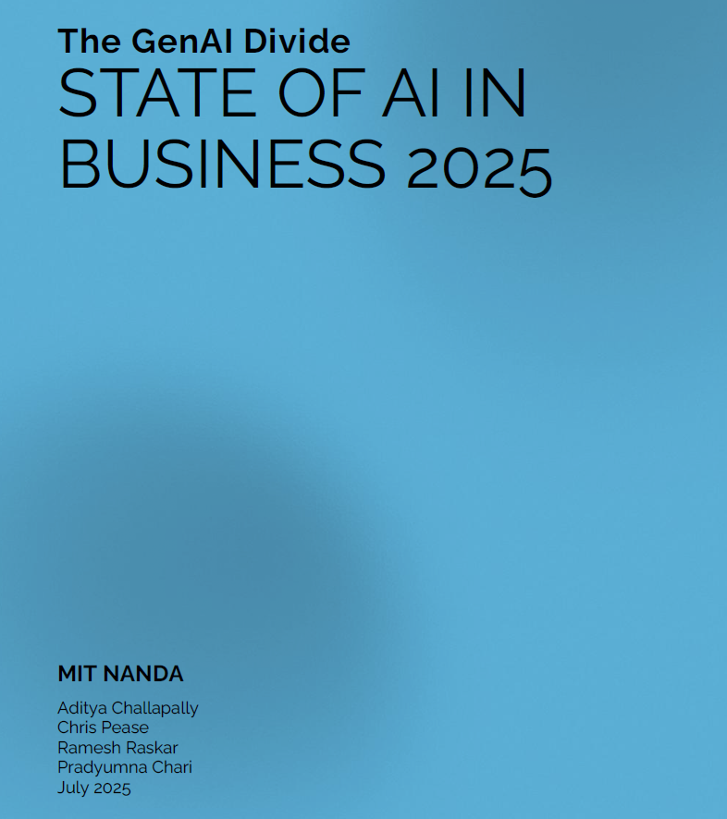
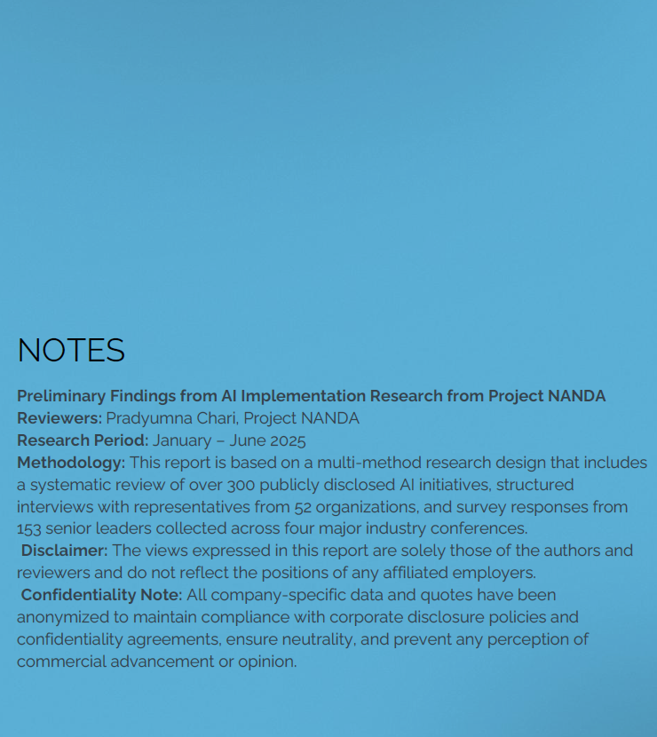

Slide 17
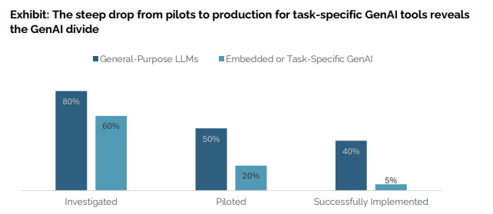
The GenAI Divide is starkest in deployment rates, only 5% of custom enterprise AI tools reach production. Chatbots succeed because they're easy to try and flexible, but fail in critical workflows due to lack of memory and customization.

Slide 18
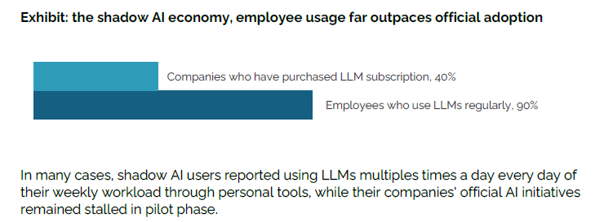

Slide 19
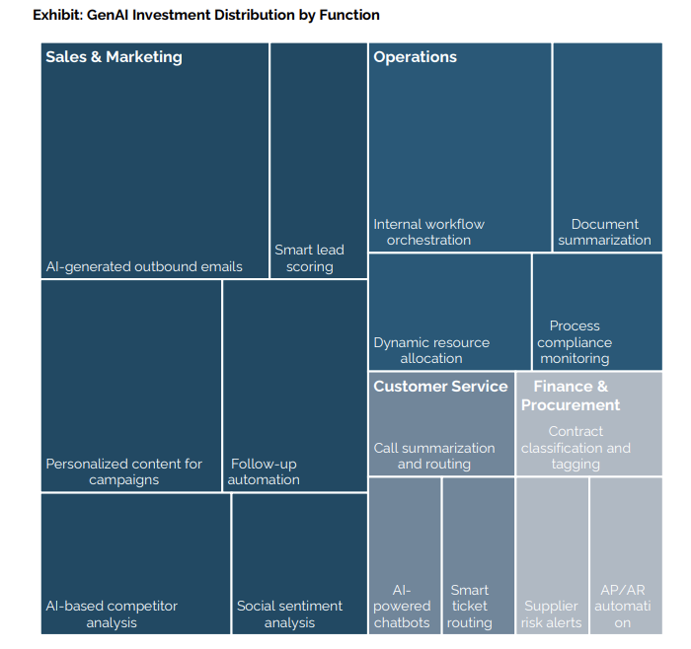

Slide 20
Final Project Take-Away
Gen AI – LLMs have wide individual adoption and widespread investigation at the enterprise level
What's holding enterprise adoption is that most AI tools don't learn and don’t integrate well into workflows.

Slide 21
Team check in, roles
By the end of this class:
Finalized roles within the team including:
Building/simulating data retrieval and cleaning
Building the proof-of-concept with RPA support
Building the proof-of-concept agent
Slide deck owner and presentation roles
Any video demo of the bot (recommended)

Slide 22
Team check in, content
By the end of this class:
Finalize the process being automated with clear roles for:
RPA bots / Agents
How this aids the human decision
The economics of the bot and scalability potential
How the agent adds value to the target audience

Slide 23
Team check in, proof-of-concept
By the end of this class:
Decide or map out the workflow and pass it by me, including:
Explicit RPA steps in logical order, location of an agent in the workflow
What the agent needs (data) and what the agent does
Confirm the workflow style (maestro versus studio)

Slide 24
Thank you

Slide 25
Appendix
Reminder of Final Project Requirements

Slide 26
Intelligent Automation Team Challenge
A team project that focuses on an enterprise level automation robot aimed at solving an Accounting & Finance problem.
The bot can be demonstrated in a proof-of-concept state.
Has a Generative Artificial Intelligence (LLM) and/or Agentic AI / AI Agents component.

Slide 27
Requirements
Software deliverable: A prototype (or example) of a solution to the problem.
Presentation deliverable: Discussion of the problem being solved, how the agent benefits the task or workflow, and an evaluation of the usefulness of the Agent or LLM example.

Slide 28
Accounting & Finance Focus Areas
We will focus on the following core areas:
Financial Performance & Forecasting
Budgeting & Financial Planning and Analysis (FPA)
Project Evaluation & Risk
Teams have the option to choose from these areas (or some other options).

Slide 29
Structuring the problem
I will provide each team with a problem from within the Accounting & Finance Function* for this problem, you will be asked to present an AI- agent solution to the use-case focusing on:
What does an intelligent agent need to know, compute, and determine/reason?
* If your team is interested in solving a different problem from the pool of potential ones I offer let me know

Slide 30
Structuring the project
The project will have each team focus on
What are the appropriate inputs/data?
What is the model or logic used to solve the problem?
What decisions and explanations do I want the agent’s help on?

Slide 31
Financial Analysis & Forecasting
Data: transactions, financial statements, earnings reports
Logic: Trend analysis & ratio analysis
Agent Role: Explain performance & generate insights, predict outcomes & explain key assumptions
Users/audience: Internal (managers) and external (investors) to the firm

Slide 32
Budgeting and & Financial Planning and Analysis
Data: Transactions / budgets versus actuals reports (internal).
Logic / tools: variance analysis, relevant costs, cost allocation.
Agent roles: Diagnose what went wrong (missing a budget target), aid in filtering decision-relevant information (relevant v irrelevant costs).
Users/audience: Internal management decisions.

Slide 33
Project Evaluation & Risk
Data: investment targets, risk/return estimates and cost of capital, projected future cash-flows.
Logic tools: Time value of money, valuation, capital asset pricing models.
Agent roles: Rank & Recommend Investment decisions based on a set of targets, simulate uncertainty and risk analysis and/or evaluate investment trade-offs over time.
Users/audience: Mangers and investors.

Slide 34
Some other potential focus areas
Fraud Detection
Portfolio Management
Environmental, Social and Governance reporting
Personal Finance
Wealth Planning
Tax Optimization
Compliance
Cybersecurity
Blockchain

Slide 35
Structuring the data
Simulate data internal company inputs for this task or use real company disclosures and/or stock prices.

Slide 36
Proof-of-concept / prototype
Multiple possible approaches:
Goal: Proof of agent concept (UiPath, Python, LLM) without automation **do this part first.
Goal: Proof of concept process map in business process mapping notation (BPMN) **do this second.
Goal: Working automation workflow prototype with agents using business process mapping notation (UiPath, Python). **optional; do this third.

Slide 37
Presentation Preparation
Each team will present for up to 15 minutes plus up to a 5 minute Q&A.
What is the problem, why is it important
What your solution achieves
Mechanics of the solution (data inputs, process, outputs)
Conclusion and Q&A
Non-presenting class members are expected to ask questions.

